Slide 1
Hydrological Information System
Module – Telemetry Systems
Anish
….. Hydro-Informatics Expert
The World Bank

Slide 2
Examples that refer to products are intended for illustrative purposes only, and do not imply an endorsement or recommendation of any particular product

Slide 3
Module Contents
Communication Options
Earth Receiving Station
Transmitter Specification
ERS Specifications

Slide 4
Telemetry
Data logger to Control Room
  Earth based Communication
    GSM / GPRS
  Satellite Based Communication
    INSAT
    VSAT
Introduction

Slide 5



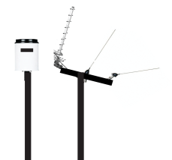
GSM/GPRS
Concept
  GSM/GPRS systems can work by sending text messages and/or data files
  Allows two-way communication, with the ability to change program settings, download data, or just query for the most recent measurements.
GSM Communication
Internet
Decision Support Center

Slide 6
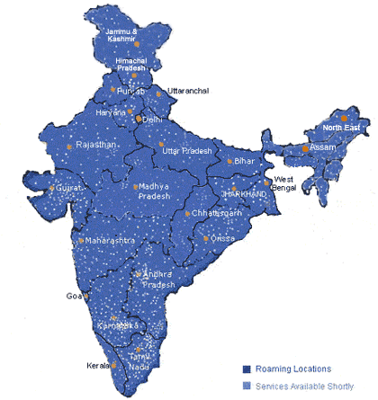
GSM/GPRS General Information
Transmission:
  900 MHz and 1.8GHz
Regulation:
  Open for public use. Just need service agreement with mobile network provider
The Coverage
  Makes GSM telecommunication a popular choice though there are several very important factors a hydrologic system operator must consider when choosing a telecommunication medium to relay hydrologic data
    GSM/GPRS network is shared with the public
    Real-time hydrologic systems that can miss periods of data collection, such as ground water, measurement, which is fairly static over time, are more suitable candidates to employ GSM/GPRS based technology
GSM Communication
GSM Coverage in India
(taken from GSM World Coverage 2009)

Slide 7
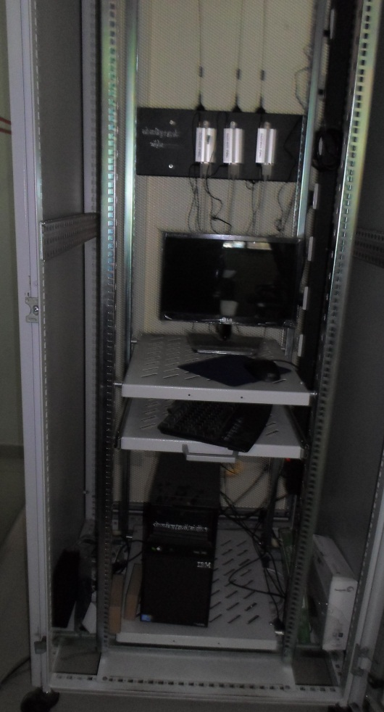
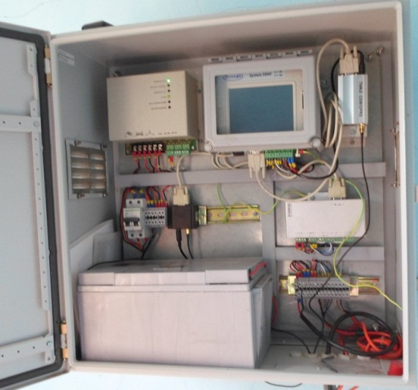
GSM General Information
Mobile Service Provider Tower
GSM Communication

Slide 8
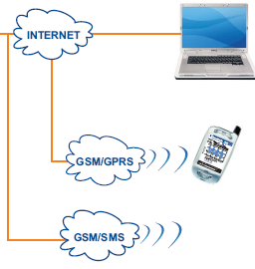
GSM - GPRS General Information
No Master control Room or ground station needed
Cloud based computing and data is made available on web

Slide 9
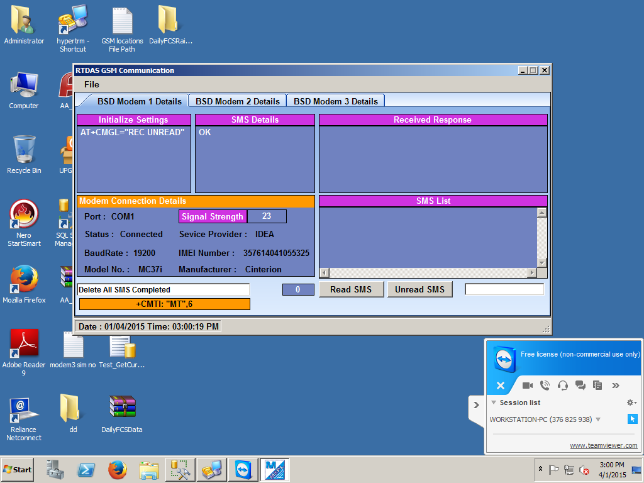
GSM/GPRS – Reception Window
GSM Communication

Slide 10
Advantages/Disadvantages of GSM/GPRS
Advantages
  Coverage widely available in India
  Quickest technology to implement, requiring only a service from mobile network provider
  Relatively inexpensive
Disadvantages
  Unreliable for public safety requirements such as flood warning and emergency management (Mobile network is a “best effort” technology)
    Likelihood is great that the GSM/GPRS bandwidth could be consumed by the public during public emergency.
    Can have high latency, especially Text Messaging
GSM Communication

Slide 11
Satellite-based solutions: INSAT
Concept
  Operated by the government of India to provide support to real-time environmental monitoring
  Well suited for remote hydrometric data collection as well as data sharing. Data sharing is implicit in the method that INSAT employs to collect and relay data
    Anyone in view of the satellite can collect all hydrometric data, including data collected by IMD and CWC, who recently have modernized their networks with capabilities of real-time data collection
INSAT Communication

Slide 12
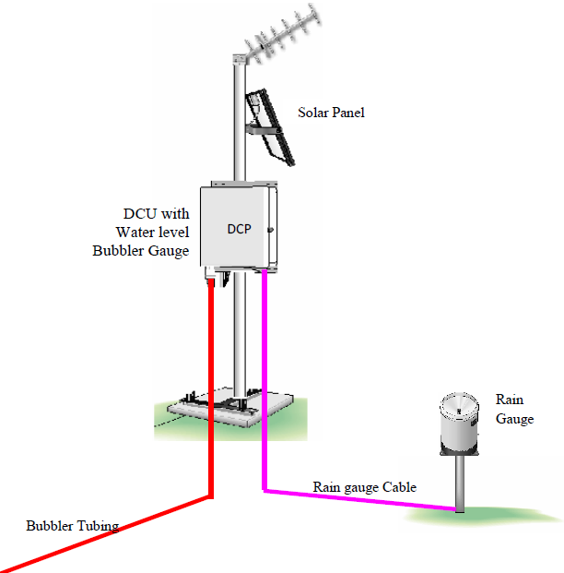
Satellite-based solutions: INSAT
Raw
Data Module
Data Transmission through satellite
Data Transmission from Remote Stations
Data
Decoding
Module
INSAT Communication
Earth Receiving Station
DAS Server
Database / Backup Server

Slide 13
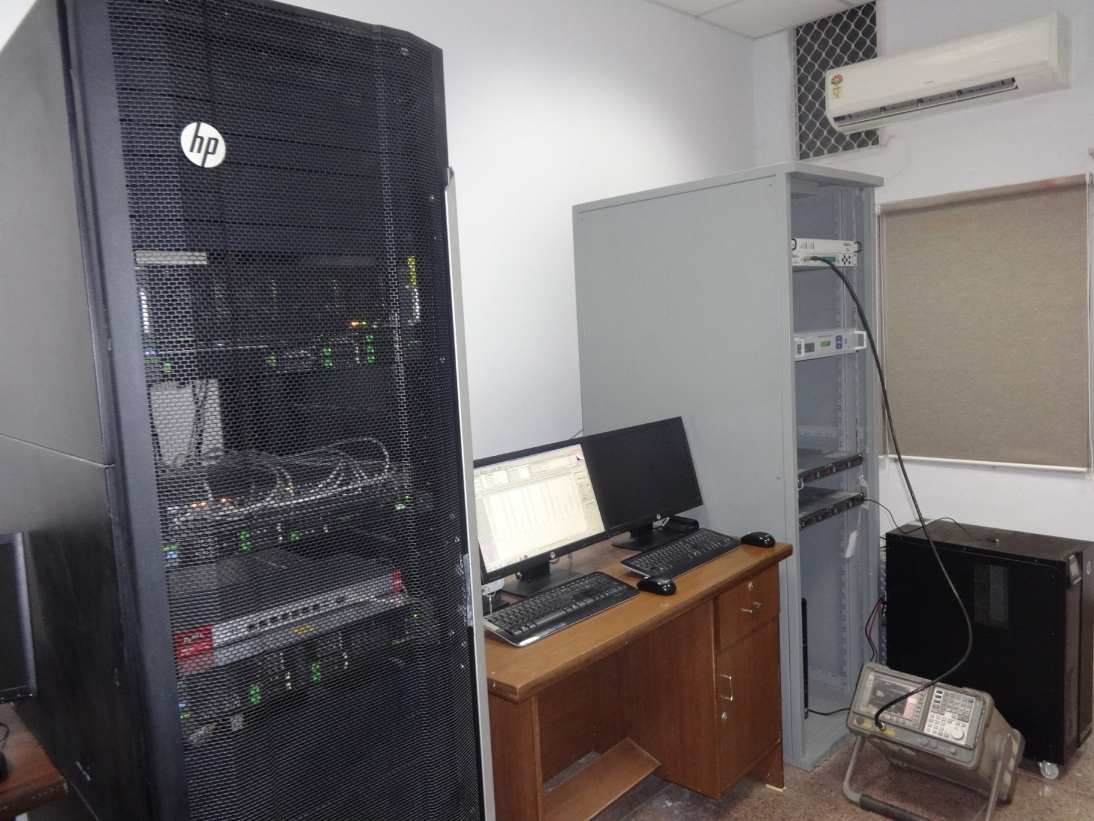
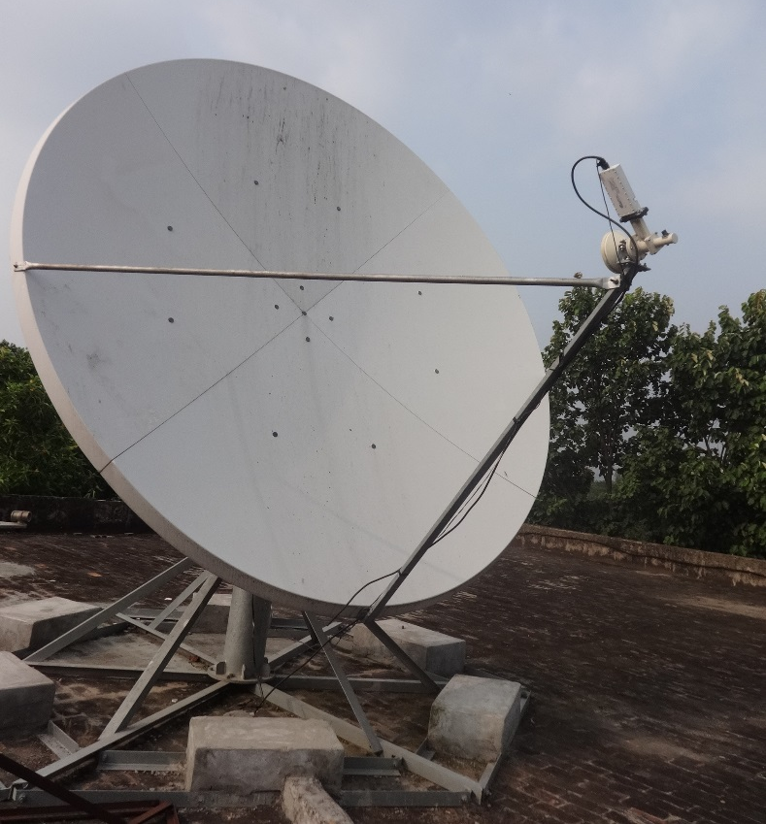
Satellite-based solutions: INSAT
Data
Decoding
Module
Raw
Data Module
INSAT Communication
DAS Server
Dish on Rooftop
Database and backup Server

Slide 14
Advantages/Disadvantages of INSAT
Advantages
  One of the great advantages of INSAT is that communication is possible from virtually anywhere in India
  Satellite is not affected by local weather events that can often disrupt terrestrial-based communications, such as GSM/GPRS.
  High reliability and implicit data sharing
  Operates on very low power
  Low running cost
Disadvantages
  WPC clearances and Licenses fee required
  One way communication
  Radios are more expensive than GSM
  Requires a ground station
INSAT Communication

Slide 15
Satellite-based solutions: VSAT
Concept
  Privatively owned companies
  Bi-directional communication
  Complete Internet Solution (through satellite)
  Direct communication, though in some cases ground hops may exist
  Well suited for SCADA, which requires bi-directional communication
VSAT Communication

Slide 16
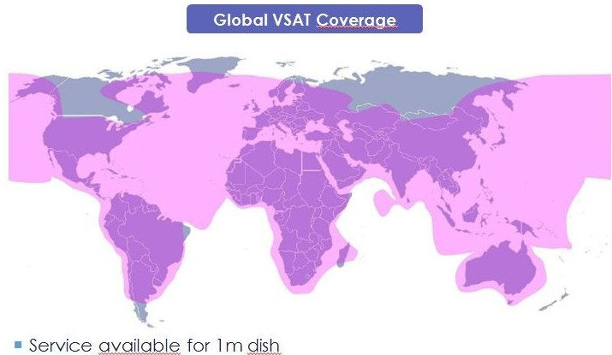
Satellite-based solutions: VSAT
VSAT Communication

Slide 17
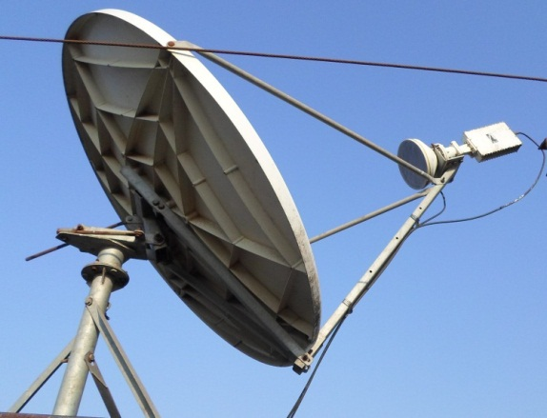
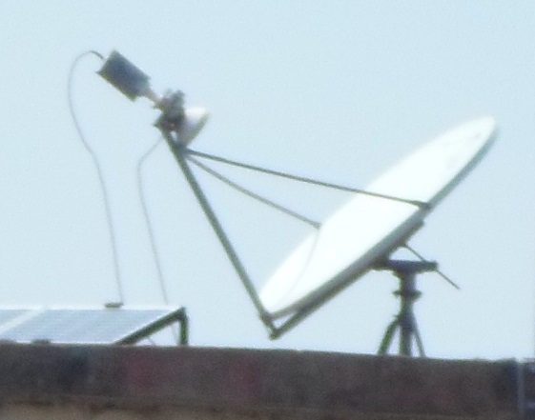
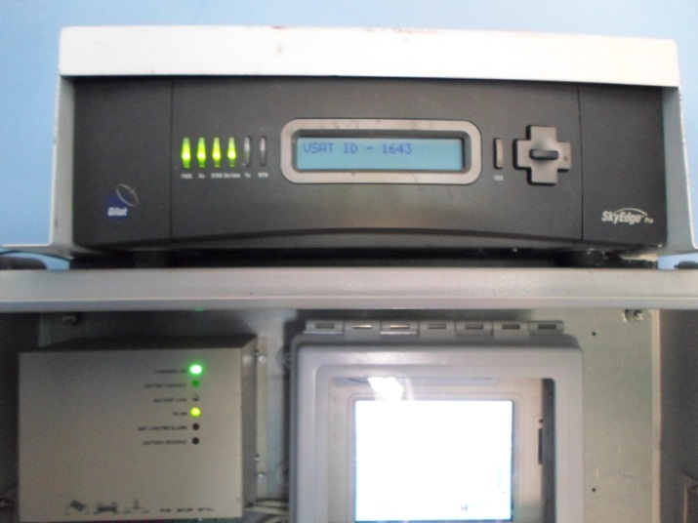
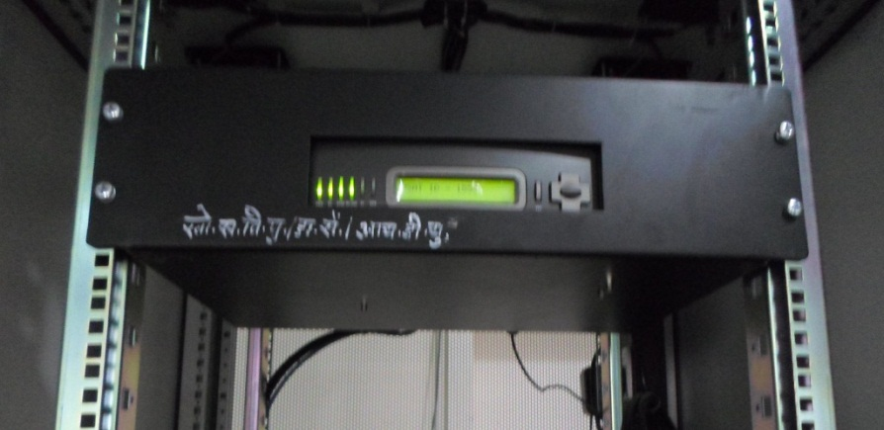
Satellite-based solutions: VSAT
VSAT Communication
Remote Station
Server Room

Slide 18

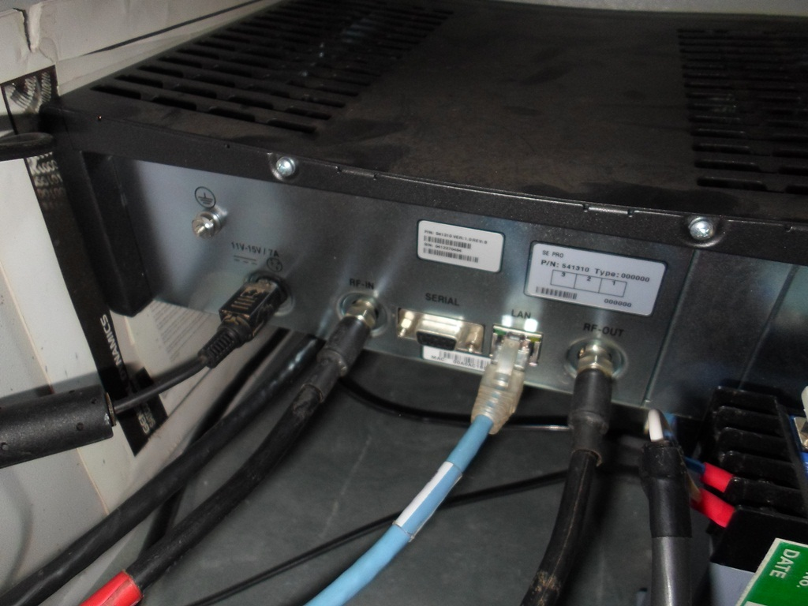
VSAT – Closer Look
VSAT Communication

Slide 19
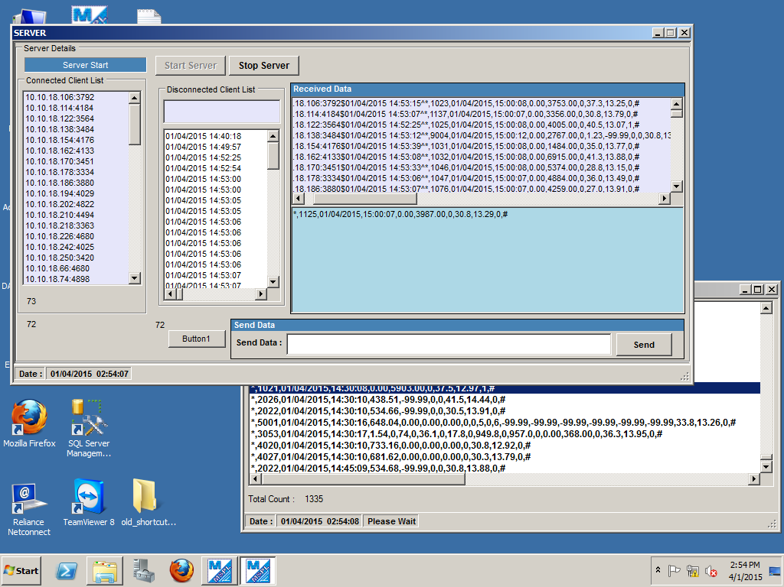
VSAT – Reception Window
VSAT Communication

Slide 20
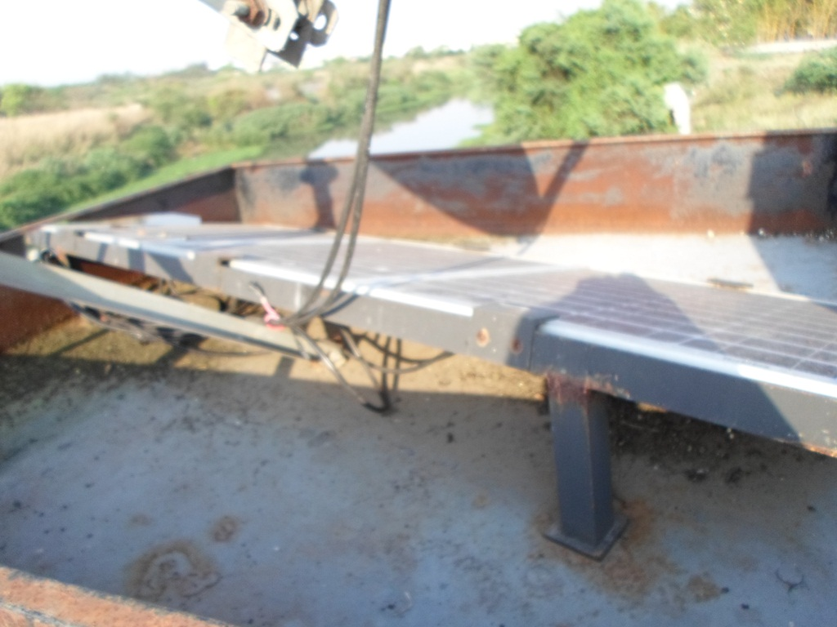
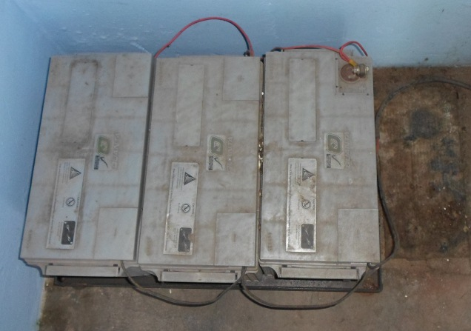
VSAT Power Consumption
VSAT Communication
VSAT Communication needs much higher power, so size of Solar panels and Battery backup goes up

Slide 21
Advantages/Disadvantages of VSAT
Advantages
  High reliability (if using Direct Connection)
  Bi-directional communication suitable for SCADA and interaction with data station (reprogramming)
  Radio licensing fees assumed by VSAT provider
  Used by banks and other institutions that require high availability
Disadvantages
  Large antenna/dish
  Uses more power than one-way devices
  High recurring cost (though this can be minimized with proper integration)
VSAT Communication

Slide 22
Factors in Deciding a Best Fit in Data Communication
Factors
  Availability
  Cooperation and Economy of Scale
  Cost (initial purchase)
  Recurring cost (Use Fee)
  Data Distribution
  Latency
  Maintenance
  Privacy
  Sustainability
Communication Options

Slide 23
Factors: Availability
Ensures a certain degree of operational continuity over a given period.
Disruptions of the data stream lead to loss of data
Measured as a percentage of time the system can be expected to operate over a given amount of time
High availability solutions include:
  Satellite-based relay systems, such as INSAT
Low availability solution include:
  GSM/GPRS
Additional Notes:
  There is an increased cost to achieve increasing availability.
  Higher system availability can also be achieved by providing backup communications.
  Some users, such as those that have a public safety mission, usually have requirements for the highest availability.
Communication Options
 | Availability
GSM/GPRS | Medium
INSAT | High
VSAT | High

Slide 24
Factors: Cooperation and Economy of Scale
If there are cooperators that are using a given technology, this may sway the user to also employ same technology
Rather than replicating networks, various agencies can use each others network and save significant resources
In addition, with multiple cooperators sharing a given technology means that there is a built-in support system amongst the users of the data
Communication Options
 | Cooperation & EC
GSM/GPRS | Medium
INSAT | High
VSAT | Medium

Slide 25
Factors: Cost (Initial Purchase)
The initial cost of the installation of a real-time data collection system can vary greatly by solution
Low cost system:
  Mobile phone network (GSM/GPRS)
High cost system:
  VSAT Systems
  INSAT, if the user must purchase an INSAT ground station, which can be in excess of 80,00,000 INR
Communication Options
 | Cost (Initial)
GSM/GPRS | Low
INSAT | Medium
VSAT | Low

Slide 26
Factors: Recurring Cost (Use Fee)
There is an initial cost to installing equipment, and a recurring cost of operating the equipment
Some solutions have user fees, while others do not
  Mobile phone network users must pay for the use of the network
  Changing telecommunication methods after the initial installation of equipment can be great, so it is incumbent upon the user to consider recurring fees and the uncertainty of the cost of the technology in the future
Communication Options
 | Recurring Cost
GSM/GPRS | Medium
INSAT | Low
VSAT | High

Slide 27
Factors: Data Distribution
It is often an advantage to employ a real-time data relay system that inherently provides data distribution
Good Data Distribution:
  INSAT, where data from all users is transmitted from space to all points in India. All one needs is a satellite ground station
Difficult Data Distribution:
  Terrestrial based radio system, and GSM/GPRS
Communication Options
 | Data Distribution
GSM/GPRS | Low
INSAT | High
VSAT | Medium

Slide 28
Factors: Latency
Latency in hydrometric data systems has to do with the delay from the time the data is measured to the time it is received by the user
Institutions that have a public safety mission generally require the least latency, as increased latency reduces the lead time to react to a given situation
Institutions that are tasked to monitor flash floods, tsunami, or other natural threats to the population and industry are examples of systems that require low latency
Most hydrometric data relay solutions have very little delay from the time of data collection to reception by the user
Communication Options
 | Latency
GSM/GPRS | Low
INSAT | Low
VSAT | Low

Slide 29
Factors: Maintenance
Some hydrometric systems have greater exposure to substantial maintenance issues
High Maintenance
  VSAT Systems
Low Maintenance
  GSM/GPRS and the INSAT data collection system
Communication Options
 | Maintenance
GSM/GPRS | Low
INSAT | Low
VSAT | Medium

Slide 30
Factors: Privacy
In some instances the monitoring agency may want to keep hydrometric information private
  This is not typically the case of most agencies operating hydrometric systems, as data is shared to avoid duplication of effort
High Privacy
  GSM
Low Privacy
  INSAT
Communication Options
 | Privacy
GSM/GPRS | High
INSAT | Low
VSAT | High

Slide 31
Factors: Sustainability
Complexity of the solution that is being utilized.
  If a given user is the only one using a certain technology, then the challenges for sustained operations are more of a challenge.
  If real-time telemetry solution is shared among many cooperating agencies, then this leads to a much greater chance of sustainability.
  Control a user has over the technological solution being used can lead to greater sustainability
  Highly sustainable solutions
    GSM is mostly under the control of the user. This generally leads to a more sustainable solution.
    INSAT is also a highly sustainable solution because of the commitment of IMD and ISRO to fund this important component of the INSAT services.
Communication Options
 | Sustainability
GSM/GPRS | Medium
INSAT | High
VSAT | Medium

Slide 32
Factors: Comparison
 | GSM/GPRS | INSAT | VSAT
Availability | Medium | High | High
Cooperation & EC | Medium | High | Medium
Cost (Initial) | Low | Medium | High
Data Distribution | Low | High | Medium
Latency | Low | Low | Low
Maintenance | Low | Low | Medium
Privacy | High | Low | Medium
Recurring Cost | Medium | Low | High
Sustainability | Medium | High | Medium
Communication Options

Slide 33
Earth Receive Station (ERS)
Every real-time HIS network will need a Earth Receive Station at a Data Center to receive data from the remote stations automatically. An Earth Receive Station (ERS) is also referred to as a Base Station (BS) or Ground Receive Station (GRS)
The ERS will utilize a dedicated server for the collection of data in real-time so that no other processes interfere with the collection of data to be provided by the bidder.
Earth Receive Station

Slide 34
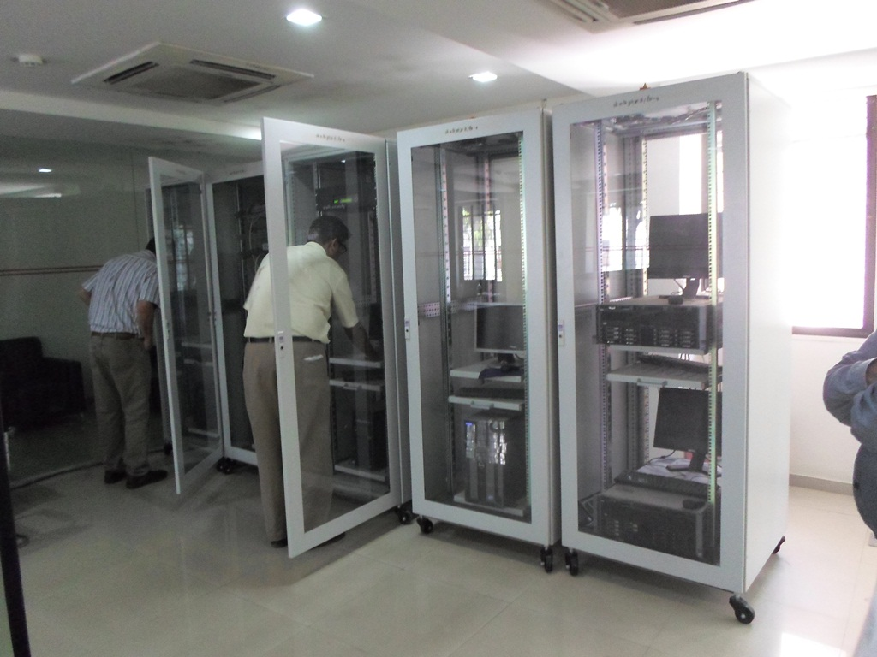
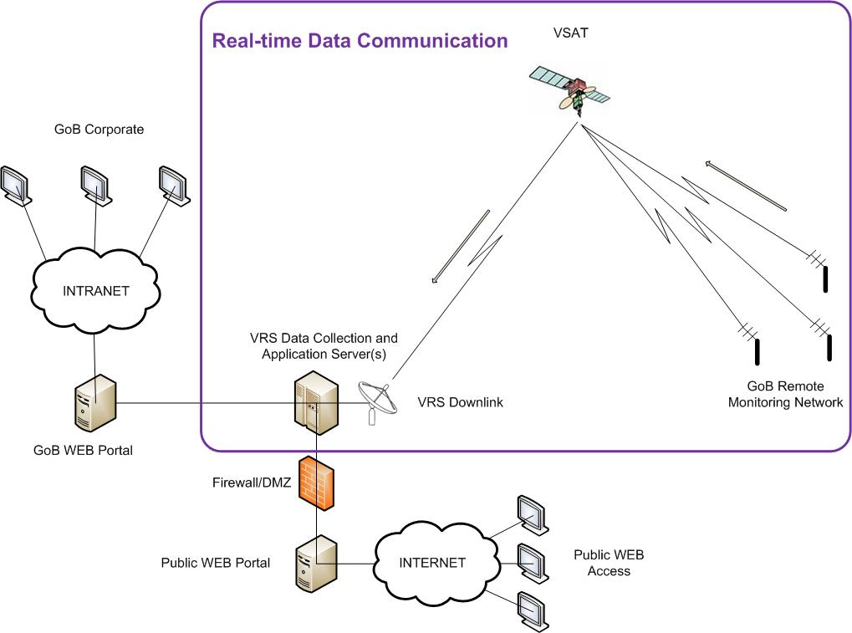
Typical Data Receive System
Earth Receive Station

Slide 35
INSAT Transmitter
INSAT Radio System to be Used on the INSAT Satellite operated by ISRO
Required to transmit on all series of INSAT satellites
Certificate of acceptance required by ISRO and/or IMD as part of the bid package
Demonstrated use of the satellite radio with at least 200 radios in current operation in India using INSAT
All associated equipment, including GPS, GPS Antenna, INSAT Antenna, all cables and mounting hardware
Antenna cable to be of high grade, LMR 400 or better
Temperature: Operating -40 to 60C
Transmitter Specifications

Slide 36
VSAT Transceiver
VSAT Radio system to allow two-way communication system between Data Center and remote station
VSAT communication will be direct link, and use the internet or any surface based topology for data communication (i.e. leased lines)
VSAT bandwidth will be able to be shared among all transmitters
VSAT remote stations shall be able to transmit based on alarm conditions at the remote site such as critical water level or exceptional precipitation events
All associated equipment, including Antenna all cables and mounting hardware
Antenna cable to be of high grade, LMR 400 or better
Temperature: Operating -40 to +60C
Transmitter Specifications

Slide 37
GSM/GPRS Transmitter
Utilize GPRS network for two-way TCP/IP (INTERNET) connection
Radio to utilize VPN protocol
Data collection to be triggered by interrogation from Data Center, or by event based transmission triggered by remote site
Ability to disable interrogation system in order to save power at remote site
Data transmission to execute HTTP Post or FTPS to transmit data to the Data Center
All associated equipment, including Antenna all cables and mounting hardware
Temperature: Operating +40 to 60C
Transmitter Specifications

Slide 38
ERS General Requirements
A computer server (rack mount) is required to process the incoming data. Processing includes but is not limited to:
  Quality Control Checks and Rejection of Bad Data
  Alarms based on malfunctioning remote stations
  Provision to relay data to data base and/or applications server
The computer server is required to come equipped with all server accessories, such as UPS, router, computer rack, computer rails, electrical power supply
ERS Specifications

Slide 39
ERS Server General Requirements
A computer server (rack mount) is required to process the incoming data.
All of the following specifications are minimum specifications. The Bidder will increase these specifications as required to support the Bidders Software and Hardware Solution
CPU – Pentium IV 3.0 GHz
Memory – 16 GB
Hard Disk – Capable of storing raw data for 500 stations for 10 years or a minimum of 1 TB. Hard Disk will be configured as RAID 1 with hardware controller, which means the Disk space will be effectively doubled
Monitors – Three computer screens (server is required to have necessary hardware to support all three screen). Screens minimum 21”, flat screen.
Wireless Keyboard and Mouse
Optical Drives – CD/DVD RW+
Network – Two network adapters 10/100/1000Mbps (RJ45)
Ports – Serial, parallel, 4-USB
Electrical – Supply voltage: 230V nominal
Operating System – Windows Server 2010, or most current.
ERS Specifications

Slide 40
ERS Server Software General Requirements
Software for decoding remote station data, and routing this data from the ERS to other computer nodes (i.e. FTPs, HTTP POST, and/or shared drive)
Diagnostic software:
  Station/sensor malfunction/outage, with automatic report generation and alarm protocol
  Received Signal Strength (if applicable)
Storage of all Raw Data on non-proprietary data base, and non-proprietary data base structure (i.e. PostGreSQL, MySQL)
Graphical and tabular viewing software, with user selectable stations and time period (up to one year)
ERS Specifications

Slide 41
INSAT ERS
System Characteristics:
  Required to collect all INSAT transmissions (IMD, CWC, SASE, etc.), regardless of transmitter manufacturer or transmit format
  Overall data collection system performance better than 99.9% error free data (Receiver must collect all data successfully transmitted from any remote station transmitting through INSAT)
INSAT 3.8m (minimum) receive dish capable of receiving data from remote stations according to performance standards set forth above.
Receiver, antenna, cabling, and all other accessories necessary to have a fully functional and reliable ERS
Front panel indicators on receiver for signal acquisition, channel activity and diagnostics
ERS Specifications

Slide 42
INSAT ERS Continued
INSAT Receive Dish System
  Appropriate size to assure collection of ALL data from remote stations
  Antenna Pedestal Type – Fixed EL/AZ antenna mount
  Wind Speed Operational Survival – 140 km/h or higher
  Lightning protection on all coaxial cables entering the building, as well as on all power feeds. Grounding will utilize Single Point Grounding Technique
C-Band LNB
  As required for successfully receiving 99.9% of all data transmitted through INSAT
Receiver
  As required for receiving 99.9% of all data transmitted through INSAT
ERS Specifications

Slide 43
VSAT Earth Station Specification
An VSAT System requires the ERS to receive transmissions directly from the VSAT satellite, and not data which is relayed through the Internet
System Characteristics:
  Overall data collection system performance better than 99.9% error free data (Receiver must collect all data successfully transmitted from any remote station transmitting through VSAT)
VSAT receive dish capable of receiving data from remote stations according to performance standards set forth above.
Receiver/modem, antenna, cabling, and all other accessories necessary to have a fully functional and reliable ERS
Front panel indicators on receiver for signal acquisition, channel activity and diagnostics.
ERS Specifications

Slide 44
GSM/GPRS Earth Station Specification
A GPRS Earth Station receives GPRS data through the Internet, as there is no direct method of data collection such as that possible on INSAT and VSAT
A GPRS System requires a highly reliable Internet connection to receive data being relayed through the mobile network
There are no receivers required as transmissions will arrive by way of the Internet
ERS Specifications

Slide 45

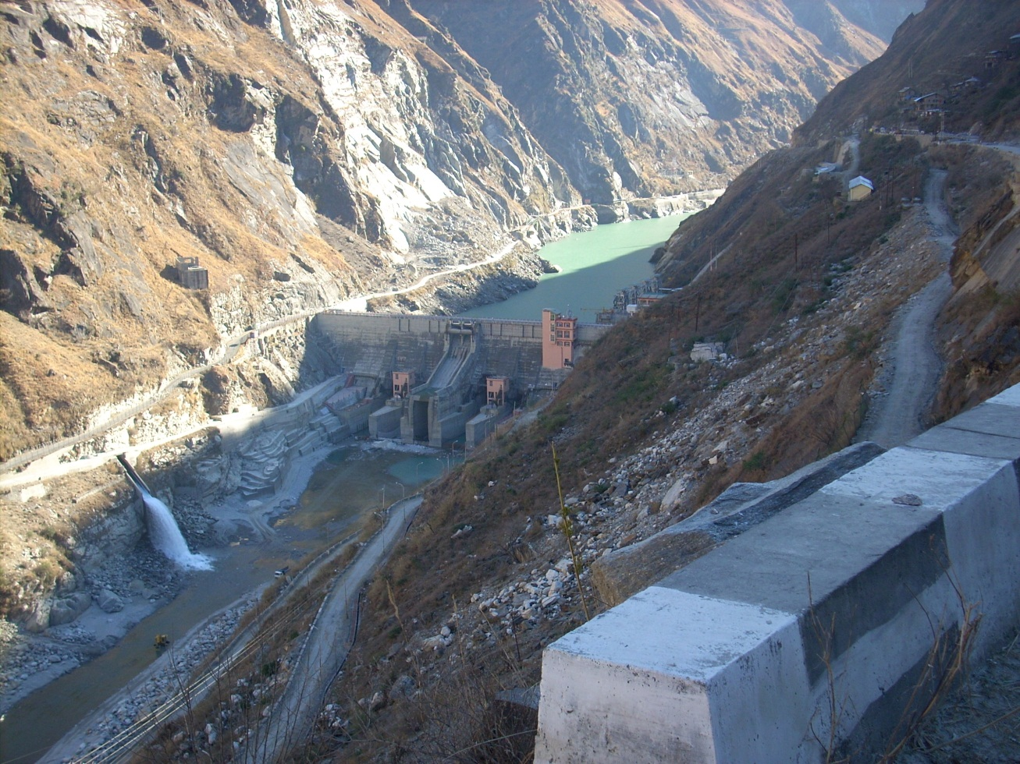
Sensor Communication Challenges
Sensor Communication

Slide 46
Sensor Communication Challenges
Sensor very far from data logger
Multiple sensors in the area (surface water, ground water, climate)
Other areas where using cable is prohibitive
  River Crossing
  Reservoir Structure (Pool elevation, river release, etc.)
Sensor Communication

Slide 47

Wireless Sensor Links
Data Communication to Data Center
Master Station
Sensor Communication
Ground Water Sensor
Water Level
Climate Station

Slide 48
Advanced Sensor Communications
Wireless Sensor Communication
  Effective in combining sensors
  Saves cost of data logger/transmitter
  Effective in reducing long wire runs, or providing data collection where running wire is not feasible or possible
  Utilizes low power spread spectrum transmission frequency (similar to that used by portable phones)
  Operates on very low power at 12/24/48 Volts
Sensor Communication

Slide 49
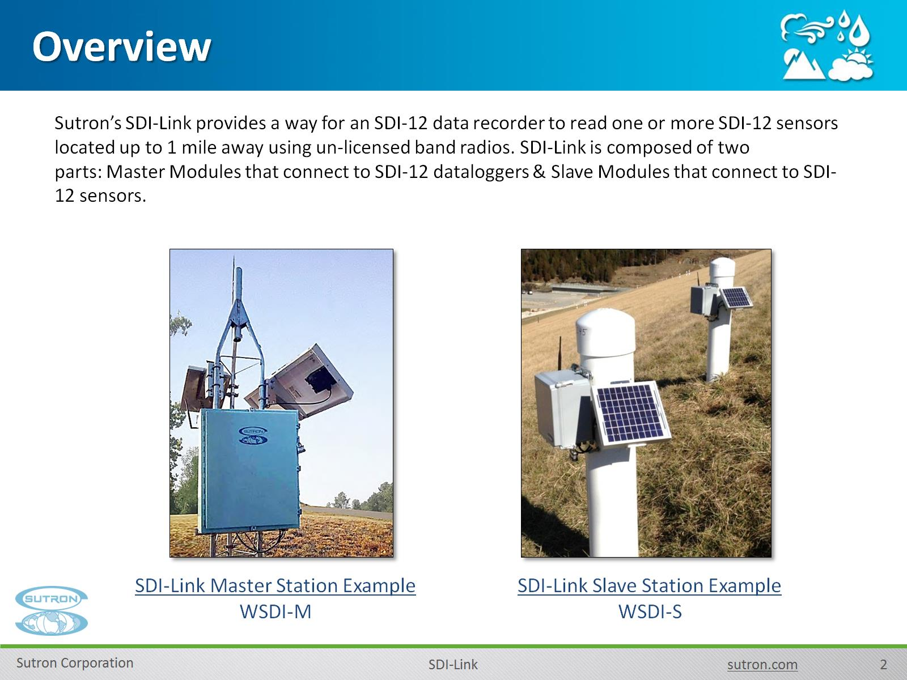
Wireless Sensor Connectivity
Slave Equipment connected to Sensor
Master Equipment Connected to Data Logger
Range varies by model, cheaper ones up to 2 KM, and some available for up to 50 KM
Sensor Communication
Wireless Radio Master
Wireless Radio Slave

Slide 50
Wireless Sensor Communication
Preferable Choice when:
  GSM coverage or Satellite line of sight available at AWS but not available at other remote sensor location
  Cost of Radio pair is lower than data logger and telemetry device
Sensor Communication

